Slide 1
BenchMark Design
DB Project
Shruti Nuchhi

Slide 2
BenchMark Systems
Postgres -
Understand how Postgres performs and scales in cases of complex queries, as a user what options we have to improve the performance.
What are the advantages and drawbacks of using indices, when to use indices and when is it better to perform a full scan.
What is that point when things start to get worst.
BigQuery -
Measure the performance of cloud vs Postgres.
Without indices how does it scale up, what options does it use to run queries which would have performed better with indices.
What is advantage/disadvantage of columnar data format.

Slide 3
Benchmark Goals
Perform query runs on Postgres and BigQuery, understand what steps are taken to execute a given query.
Understand the reasons which of them systems perform better.
What impact does indices have on query execution and when to use indices.
How does BigQuery and Postgres perform for join queries.
Measure the performance of Bigquery and Postgres across various types of queries.

Slide 4
Experiment I- Select Queries
a. SELECT * FROM TENKTUP1 WHERE unique2 BETWEEN 0 AND 99
Run the above query using no index, clustered index and non clustered index for Postgres, and a normal as is query for BigQuery.
Compare the performance of all three circumstances.
This query is run for 1% selection.
Expectation
Postgres to perform better than BigQuery as its only 1% selection.

Slide 5
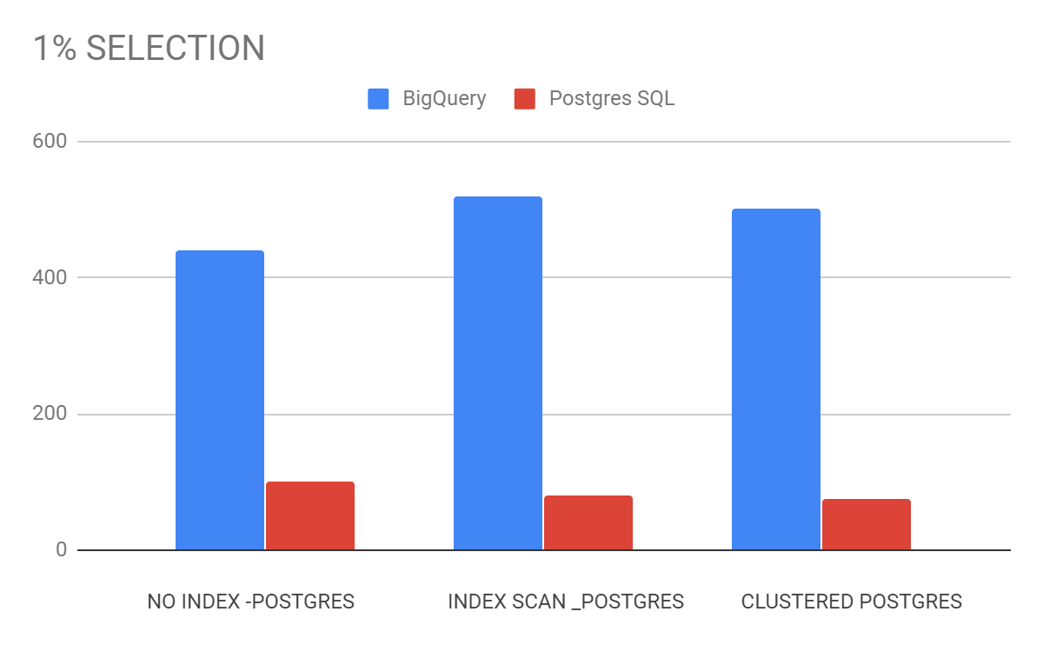
Experiment I - Results
As expected Index scan on TENKTUP1
performed better compared to sequential scan .
Bigquery took a long time compared to Postgres
to run the query.
Clustering on tenktup1 using index created
on primary key didn’t make much of a difference
in execution time.

Slide 6
Experiment I- Select Queries
b. SELECT * FROM TENKTUP1 WHERE unique2 BETWEEN 500 AND 3000
Run the above query using no index, clustered index and non clustered index for Postgres, a normal as is query for BigQuery and a BigQuery with partition on table.
Compare the performance of all three circumstances.
This query is run for 15% selection.
Expectation
Postgres to perform better with clustered index or sequential scan rather than index scan. BigQuery with partition to perform better.

Slide 7
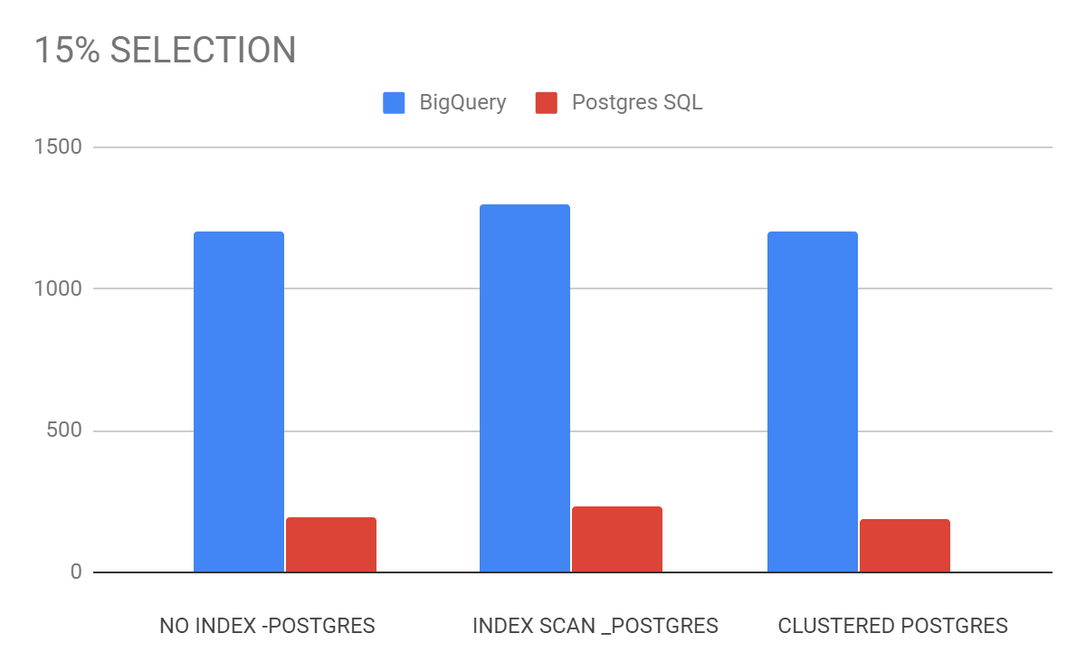
Experiment I - Results
At 10% I didn’t see change, so experimented with
12% and 15%. AT 15% I saw that Postgres with
index scan started performing slow compared
to index scan.
Bigquery took a long time compared to Postgres
to run the query. Infact Bigquery performed quite
bad at 15% selection. It took almost double the time
compared to 10% selection.Also partition of table
can be done only with ingestion time so partitioning
the table didn’t help in anyway
Clustering on tenktup1 using index created
on primary key didn’t make much of a difference
in execution time, when compared to sequential
scan.

Slide 8
Experiment II- Join Queries
SELECT * FROM TENKTUP1, TENKTUP2 WHERE (TENKTUP1.unique2 = TENKTUP2.unique2) AND (TENKTUP2.unique2 < 1000)
Perform join on index attribute using various join algorithms such as hash join, merge join and nested loop.set enable_hashjoin=off, set enable_mergejoin=off, set enable_nestloop=off
Expecting hash join and merge join to out perform nested loop
2. SELECT * FROM TENKTUP1 a, TENKTUP2 b WHERE (a.unique1 =
b.unique3) AND ( a.stringu1 = b.stringu1)
Perform join on no index attribute using various join algorithm such as hash join, merge join and nested loop
Expecting some delay in join as they are join used non index attribute

Slide 9
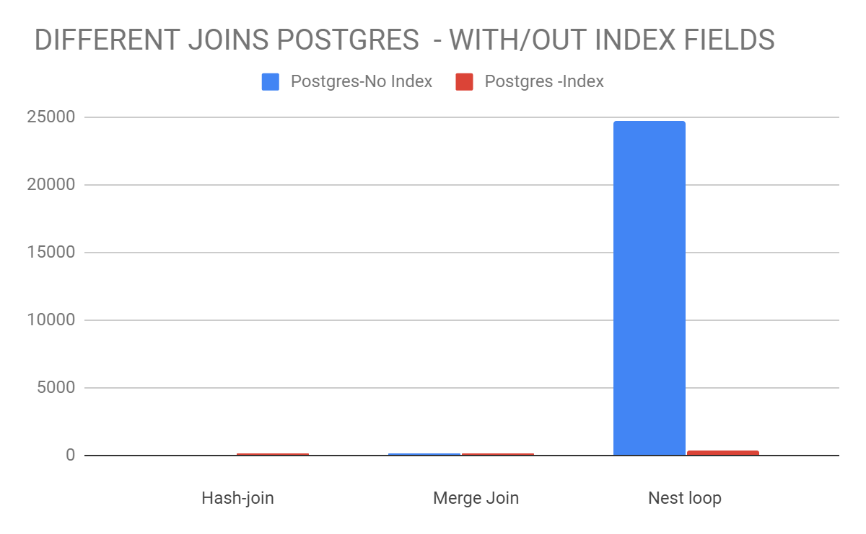
Experiment II- Results
All three algorithms performed
quite well when join using index
field(unique2)
Nested loop join on non index
performed the worst it took
almost 25 sec to complete the
query. Also even if the nested
loop join was turned off
postgres used nested loop in
absence of other join algorithm

Slide 10
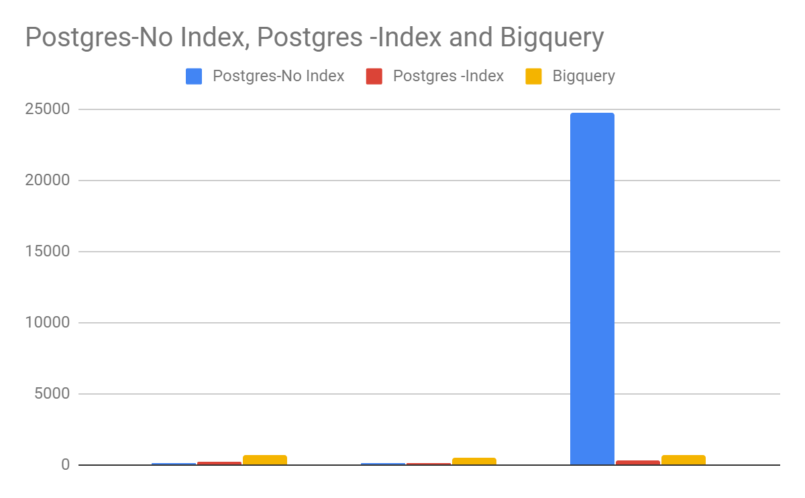
Experiment II- Results
BigQuery Joins with Postgres Join
Bigquery performance has been
kind of consistent with or without
joins . Didn’t see any major
Difference With joins. Also
bigquery performed joins using
hash join and inner to Hash join.
Interesting thing to note is that
bigquery does not allow select *
from multiple tables if the field
names of the tables are same.

Slide 11
Experiment III- Aggregate Queries
SELECT MIN (TENKTUP1.unique2) FROM TENKTUP1
SELECT MIN (TENKTUP1.unique3) FROM TENKTUP1
GROUP BY TENKTUP1.onePercent
SELECT SUM (TENKTUP1.unique3) FROM TENKTUP1, TENKTUP2
WHERE TENKTUP1.unique2 = TENKTUP2.unique2
GROUP BY TENKTUP1.onePercent

Slide 12
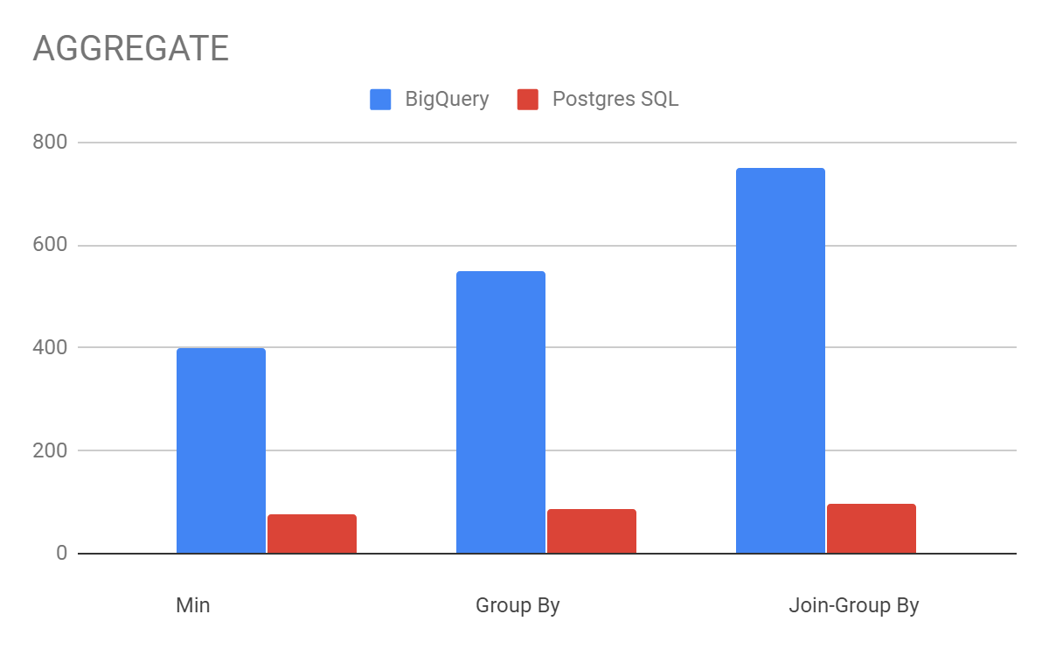
Experiment III- Results
Bigquery still is the
worst compared to Postgres
Postgres did better than
expected with the group
by queries
Both Postgres and Bigquery
performed using hash join

Slide 13
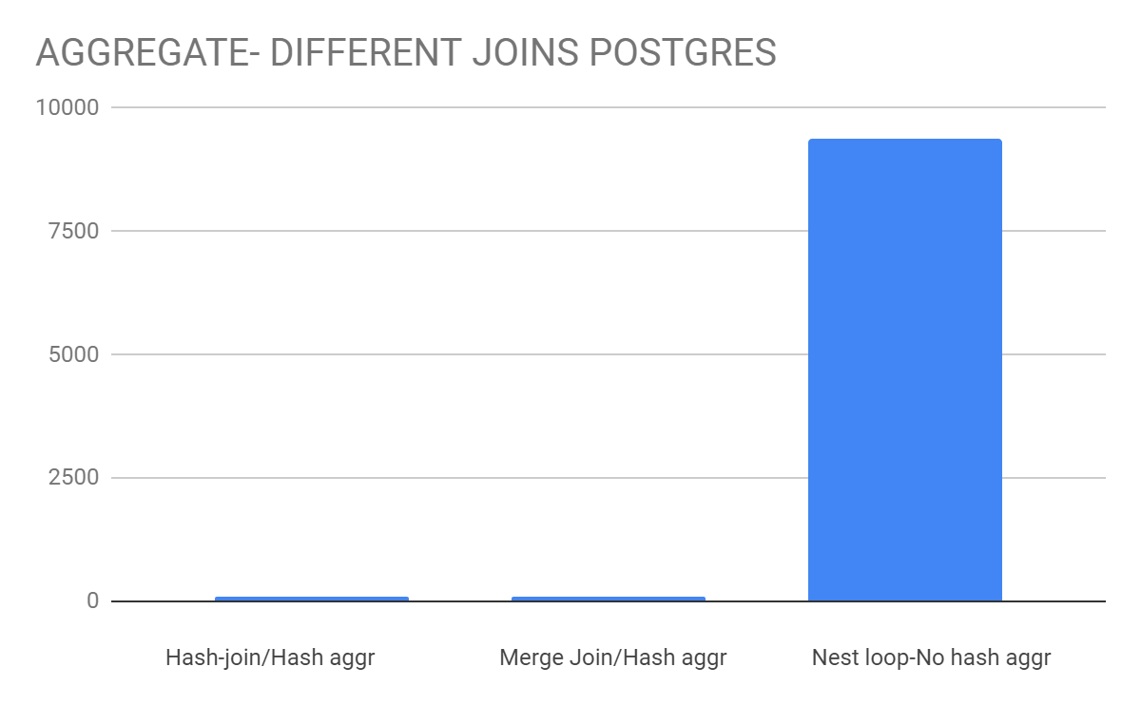
Experiment III- Results
Performed join aggr on
Postgres, as I could not find
a way to edit BigQuery
parameters.
Hash join and Merge join
did perform very similar
using the hash aggregate
Nested loop join performed
worst of all. Also even if the
nested loop was turned off
postgres used nested loop
in absence of join algs.

Slide 14
Experiment IV- Insert/ Update
INSERT INTO TENKTUP1 VALUES (10001, 10001, 0, 2,0,10,50,688,
1950,4950,9950,1,100,'MxxxxxxxxxxxxxxxxxxxxxxxxxGxxxxxxxxxxxxxxxxxxxxxxxxC','GxxxxxxxxxxxxxxxxxxxxxxxxxCxxxxxxxxxxxxxxxxxxxxxxxxA',
'OxxxxxxxxxxxxxxxxxxxxxxxxxOxxxxxxxxxxxxxxxxxxxxxxxxO')
Create INDEX TENKTUP1_INDEX ON TENKTUP1(unique1)
UPDATE TENKTUP1 SET unique2 = 10001 WHERE unique2 = 1491
UPDATE TENKTUP1 SET unique1 = 10001 WHERE unique1 = 1491

Slide 15
Experiment IV- Results
The inserts and updates didn’t make any major difference on Postgres.The were all completed in approx about ~ 60msec.
There were no significant differences seen with update on index field and non index fields. The updates were performed using the sequential scan itself.
When updates various tuples of the table also there was difference of about ~10 msec seen for Postgres.

Slide 16
Experiment IV - work_mem
Change work_mem to 256MB
Change shared_buffer to 256MB
Run the below query to see how the change of work_mem and shared_buffers makes a difference when the join aggregate queries are run.
select distinct b.ten, count(*) from tenktup2 a, tenktup1 b
where a.unique1 = b.unique1
group by b.ten
order by b.ten

Slide 17
Experiment IV = Results
Did see faster results with work_mem set to 256MB which is by default set to 4MB.
With work_mem - ~80 msec without work_mem - 107 msec
Didn’t see a major difference with changing on shared_buffers to 256MB.
Also to set shared_buffers we will have to restart the server and as such on the server we don’t get to see how of the shared_buffer is actually getting used. So I am not sure if the shared_buffer was already set to 256MB. As I read on google while doing some research around shred_buffers that, usually shared_buffers are set to 128MB or 256MB depending on the configuration of the system.

Slide 18
Conclusion
All the experiments I ran 5 times and calculated the three of them leaving the worst and best ones.
The join algorithm such as hash join and merge join do make a lot of difference in execution time.
Postgres started to perform really poor when the it had to use nested loop instead of hash or merge joins.
Bigquery on a whole didn’t meet the expectations and wasn’t able to match Postgres.
Also I wasn’t able to find a way to edit the join queries for BigQuery to see how the performance would change when hash join is not used.

Slide 19
Lessons Learnt
Developed a very good understanding of running queries on postgres with various parameter settings.
Learnt how join algorithm impact the execution time.
BigQuery isn’t suitable very well for the relational type of tables, as it seems like BigQuery was mainly developed with intention for running queries on large no sql databases.
Overall it was a good project to understanding how benchmarking works.

Slide 20
THANK YOU

